Slide 1






Enhanced environmental protection inspection for efficient control of air quality monitoring and of all entities under obligation within system of greenhouse gas emission allowance trading, in order to achieve better air quality in Republic of Croatia
This project is funded by the European Union

Slide 2



13. Croatian regulation reporting
Energy research and Environmental Protection Institute
Bojan Abramović dipl. ing. stroj.
Predrag Hercog, dipl. inž. medicinske biokemije

Slide 3

13.1 DATA REQUIRED TO SUBMIT
European Union IPA 2013 Programme for Croatia
Air protection information system
integral part of the Environmental protection information system that is conducted under the Environmental Protection Act that forms part of the European environmental information system
http://iszo.azo.hr/Pretraga_TS.aspx
Air protection information system is run by the Croatian Environment and Nature Agency and supervised by the Ministry (competent authority) and includes:
http://www.azo.hr/BazePodataka03
air quality data from the state network,
air quality data from measuring stations of local and local government units and measurements of special purpose provided by the polluter,
plans and programs for the protection and improvement of air quality,
Energy Research and Environmental Protection Institute

Slide 4
13.1 DATA REQUIRED TO SUBMIT
European Union IPA 2013 Programme for Croatia
Air protection information system contains (continued):
alert thresholds and information threshold exceeding data and measures for human health and environment protection on such occasions,
data on legal entities carrying out the activity of air quality monitoring, emission monitoring of pollutants in air from immovable sources, accuracy verification of the measuring system for continuous measurement of pollutant emissions from the immovable sources and quality assurance of air quality measurement and data,
performed inspection data,
committed offenses information,
other data important for the air protection, ozone layer, climate change mitigation and adaptation to climate change
……
Energy Research and Environmental Protection Institute

Slide 5
13.1 DATA REQUIRED TO SUBMIT
European Union IPA 2013 Programme for Croatia
Air protection information system contains (public and data connectivity...):
The central state administration bodies and local and regional government units, legal entity with public authority, are obliged to submit, in a timely manner and without compensation, the information from their jurisdiction required for the air protection information system management and for the preparation of the Plan, Program and Reports .
The air protection information system is aligned and linked to the information systems run by other state administration bodies, local and regional government units and legal entity with public authority.
http://www.zzjzpgz.hr/zrak/
http://zrak.zzjziz.hr/
http://www.mzoip.hr/hr/inspekcija/izvjesca-.html
Energy Research and Environmental Protection Institute

Slide 6
13.1 DATA REQUIRED TO SUBMIT
European Union IPA 2013 Programme for Croatia
Air protection information system contains (public and data connectivity...):
link to the Air quality portal in Croatia is also available on the Central State Portal on Air quality
- https://www.gov.hr/moja-uprava/stanovanje/briga-o-okolisu/kvaliteta-zraka/488
Energy Research and Environmental Protection Institute

Slide 7
13.1 DATA REQUIRED TO SUBMIT
European Union IPA 2013 Programme for Croatia
Air protection information system contains (public and data connectivity...):
Government authourity, local and regional government and legal entity with public authority possessing information relevant to air quality management and the management of the Air Information System shall be obliged to submit or make available to the Agency in electronic form at its request. (Air Protection Act, Article 119.)
The owner and/or user becomes responsible for monitoring the air quality established in the state network and in the counties, towns and cities and in accordance with the decision on the acceptability of the environmental project or the solution on the integrated environmental protection conditions, is obliged to ensure a continuous transfer of source and validated data for pollutants whose concentration in the air is determined by automatic measuring instruments for the computer network in air quality information system using the protocols and formats defined by the Agency. (Ordinance on Air Quality, Article 21. )
Energy Research and Environmental Protection Institute

Slide 8
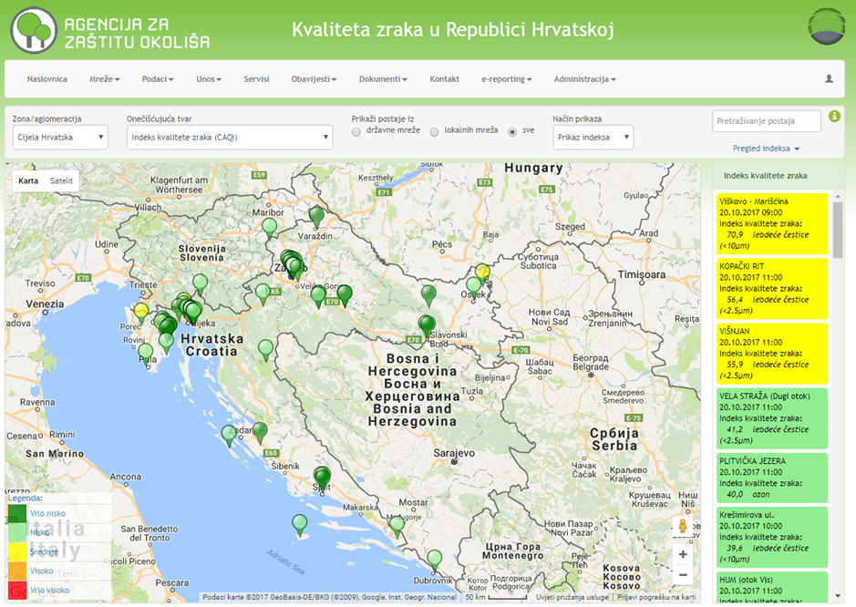
13.2 DATA SUBMITTED TO THE AGENCY DATABASE
European Union IPA 2013 Programme for Croatia
Air quality portal
http://iszz.azo.hr/iskzl/index.html
Energy Research and Environmental Protection Institute

Slide 9
13.2 DATA SUBMITTED TO THE AGENCY DATABASE
European Union IPA 2013 Programme for Croatia
Data on the Air Quality Portal or the Agency database are:
Current and validated values ​​of concentrations of pollutants in the air - statistical data, exceeded limit values and target values, alert thresholds and warning thresholds ....
Network and Station informations (metadata)
Annual reports on air quality monitoring
Action Plans and Action plans data submitted to the EC
Users also have access to static browsers, exceeding limit and target values, and trends; data are presented in tabular and graphical terms and can be downloaded (web services)
Energy Research and Environmental Protection Institute

Slide 10
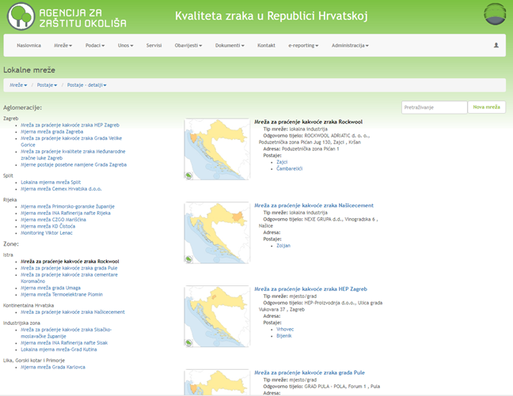
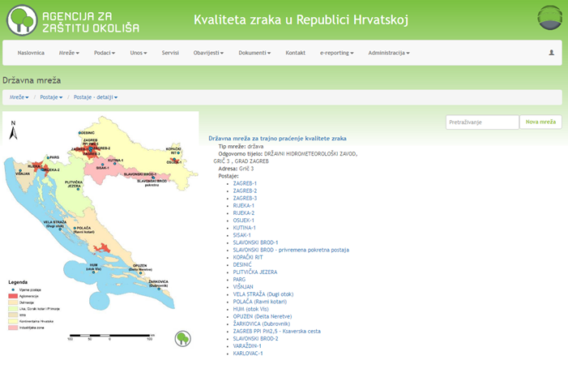
13.2 DATA SUBMITTED TO THE AGENCY DATABASE
European Union IPA 2013 Programme for Croatia
Air quality portal
Network and Station information (metadata)
http://iszz.azo.hr/iskzl/index.html
Local Network State Network
Energy Research and Environmental Protection Institute

Slide 11
13.2 DATA SUBMITTED TO THE AGENCY DATABASE
European Union IPA 2013 Programme for Croatia
Air Quality Portal in Croatia - Annual reports on air quality monitoring
Annual reports in Croatia (prepared by Agency, national and local networks)
http://iszz.azo.hr/iskzl/godizvrpt.htm?pid=0&t=0
Annual State Network Reports
http://iszz.azo.hr/iskzl/godizvrpt.htm?pid=0&t=1
Annual Local Area Network Reports
http://iszz.azo.hr/iskzl/godizvrpt.htm?pid=0&t=2
Energy Research and Environmental Protection Institute

Slide 12
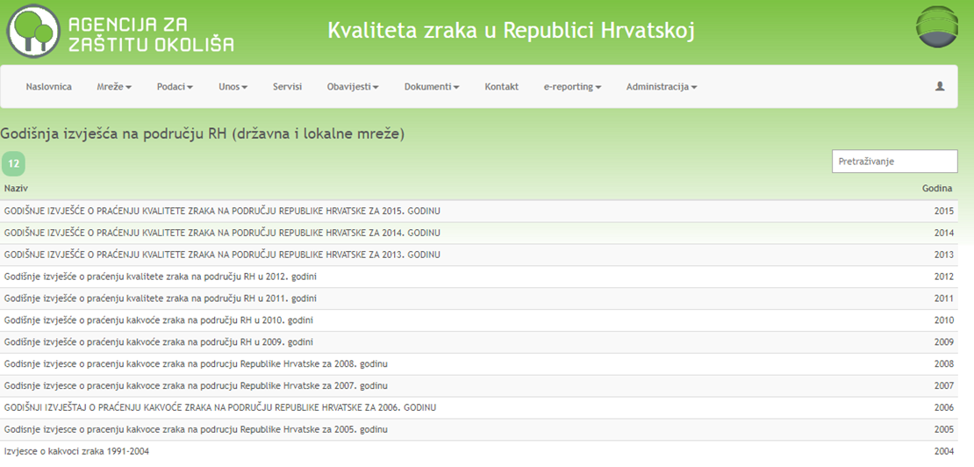
13.2 DATA SUBMITTED TO THE AGENCY DATABASE
European Union IPA 2013 Programme for Croatia
Air Quality Portal in Croatia - Annual reports on air quality monitoring
Annual reports in Croatia (prepared by Agency, national and local networks)
http://iszz.azo.hr/iskzl/godizvrpt.htm?pid=0&t=0
Energy Research and Environmental Protection Institute

Slide 13
13.2 DATA SUBMITTED TO THE AGENCY DATABASE
European Union IPA 2013 Programme for Croatia
Air Quality Portal in Croatia - Annual reports on air quality monitoring
Annual reports in Croatia (prepared by Agency, national and local networks)
http://iszz.azo.hr/iskzl/godizvrpt.htm?pid=0&t=0
Energy Research and Environmental Protection Institute

Slide 14
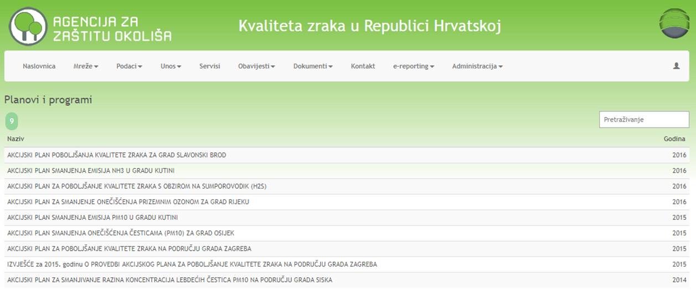
13.2 DATA SUBMITTED TO THE AGENCY DATABASE
European Union IPA 2013 Programme for Croatia
Air Quality Portal in Croatia:
Action Plans
http://iszz.azo.hr/iskzl/godizvrpt.htm?pid=0&t=4
Energy Research and Environmental Protection Institute

Slide 15
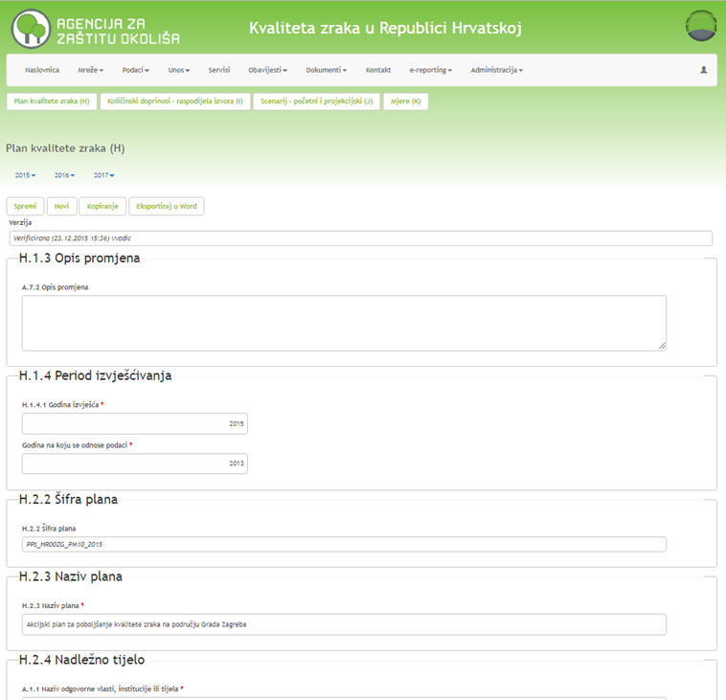
13.2 DATA SUBMITTED TO THE AGENCY DATABASE
European Union IPA 2013 Programme for Croatia
Air Quality Portal in Croatia:
data on action plans submitted to EC
http://iszz.azo.hr/iskzl/hPlan.htm
Energy Research and Environmental Protection Institute

Slide 16
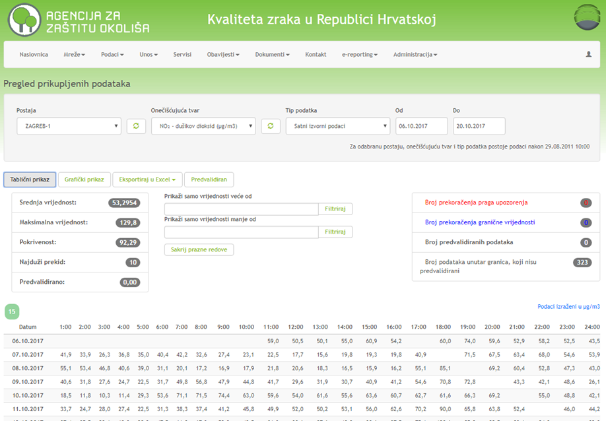
13.2 DATA SUBMITTED TO THE AGENCY DATABASE
European Union IPA 2013 Programme for Croatia
Air Quality Portal in Croatia:
Data (surce and validated)
http://iszz.azo.hr/iskzl/podatak.htm
Energy Research and Environmental Protection Institute

Slide 17
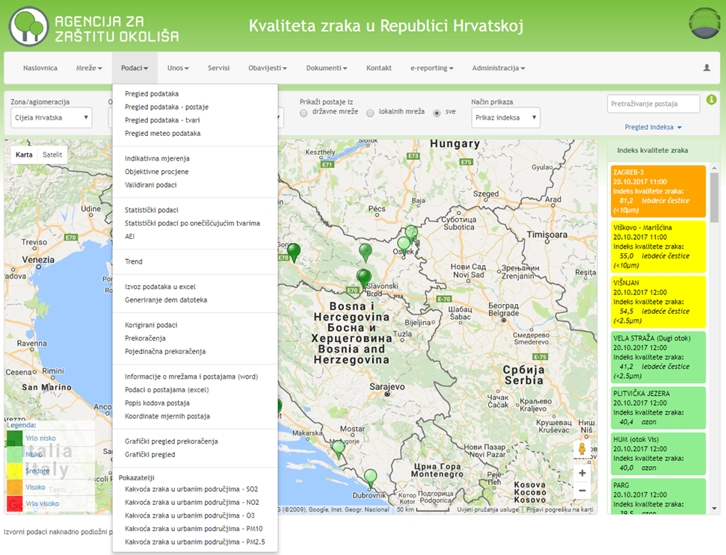
13.2 DATA SUBMITTED TO THE AGENCY DATABASE
European Union IPA 2013 Programme for Croatia
Air Quality Portal in Croatia:
Data (sourse and validated), statistical data, data on limit values and target values, notification thresholds and warning thresholds ....
http://iszz.azo.hr/iskzl/index.html
Energy Research and Environmental Protection Institute

Slide 18
13.3 REPORT ON THE BASIS OF THE INFORMATION AND ALERT THRESHOLD
European Union IPA 2013 Programme for Croatia
The alert threshold for SO₂ and NO₂ and the information threshold for ozone are set out in Annex 5 to the Regulation on levels of pollutants in the air (NN 117/12).
If the alert threshold for SO₂ and NO₂ and the information threshold and alert threshold for ozone have been exceeded in an area - the public is notified according to the Regulation on levels of pollutants in the air.
If the alert threshold for SO₂ and NO₂ and the information threshold or alert threshold for ozone have been exceeded in the state border area, the Croatian competent authority will notify the competent authority of the neighboring state.
Energy Research and Environmental Protection Institute

Slide 19
13.3 REPORT ON THE BASIS OF THE INFORMATION AND ALERT THRESHOLD
European Union IPA 2013 Programme for Croatia
Alert threshold for pollutants other than ozone:
To exceed the alert threshold, it shall be measured for three consecutive hours at locations representative places of air quality over at least 100 km², or in entire zone or agglomeration, whichever is the smaller.
Pollutant | Alert threshold
Sulphur dioxide SO₂ | 500 µg/m³
Nitrogen dioxide NO₂ | 400 µg/m₃
Energy Research and Environmental Protection Institute

Slide 20
13.3 REPORT ON THE BASIS OF THE INFORMATION AND ALERT THRESHOLD
European Union IPA 2013 Programme for Croatia
Information and alert thresholds for ozone:
For the application of Article 47. (short-term action plans) of the Air Protection Act, threshold exceedance is to be measured or predicted for three consecutive hours.
Purpose | Averaging period | Threshold
Information | 1 hour | 180 µg/m³
Alert | 1 hour | 240 µg/m₃
Energy Research and Environmental Protection Institute

Slide 21
13.3 REPORT ON THE BASIS OF THE INFORMATION AND ALERT THRESHOLD
European Union IPA 2013 Programme for Croatia
Specific measures for human health and environment protection in case of exceeding the alert and information threshold:
In the avent of information threshold being exceeded for SO₂ and NO₂ and of alert and information threshold being exceeded for ozone, the executive body of the local government in whose territory thresholds being exceeded is required to take specific measures for the human health and environment protection prescribed in Annex 6 to the Regulation on levels of pollutants in the air (NN 117/12) and to determine the manner of their implementation according to a special act regulating the prevention of major accidents involving hazardous substances.
The executive body of the local government is obliged to report an alert and information threshold to ensure media coverage through the media several times throughout the day.
The executive body of the local government through the media announces the end of the exceeding an alert and information threshold
Energy Research and Environmental Protection Institute

Slide 22
13.3 REPORT ON THE BASIS OF THE INFORMATION AND ALERT THRESHOLD
European Union IPA 2013 Programme for Croatia
SO₂ and NO₂ alert threshold exceedance and information and alert threshold for ozone in the air
the executive body of the local government in whose territory thresholds being exceeded shall be obliged to inform the public in a timely manner of detailed information on all current or predicted exceedances of alert and inforamation threshold
Energy Research and Environmental Protection Institute

Slide 23
13.3 REPORT ON THE BASIS OF THE INFORMATION AND ALERT THRESHOLD
European Union IPA 2013 Programme for Croatia
Detailed data includes the following:
data on recorded overdraft
forecast for the following afternoon / day (days):
geographic area where the alert and information threshold is exceeded,
expected changes in pollution (improvement, stabilization or deterioration), together with the reasons for such changes;
place or area of exceeding
the type of threshod being exceeded
start time and duration of exceeding
the highest one-hour concentration and, in the case of ground-level ozone, the highest ozone average concentration;
Energy Research and Environmental Protection Institute

Slide 24
13.3 REPORT ON THE BASIS OF THE INFORMATION AND ALERT THRESHOLD
European Union IPA 2013 Programme for Croatia
Detailed data (continued):
population data that is exposed, possible effects on health and recommended behavior:
data on affected population groups,
description of possible symptoms,
the recommended precautionary measures that the exposed population should undertake,
where to find further information;
data on preventive procedures for pollution reduction and / or exposure to pollutants: guidance of the sector with major sources of pollution; recommendations for emission reduction procedures.
Energy Research and Environmental Protection Institute

Slide 25
13.3 REPORT ON THE BASIS OF THE INFORMATION AND ALERT THRESHOLD
European Union IPA 2013 Programme for Croatia
Specific measures for human health and environment protection in case of exceeding the alert and information threshold:
Warnings and advices to the population:
invite the population to take care that their behavior and activities would not contribute to air pollution further and endanger the affected populations groups
recommend that fossil fuels are not used for heating rooms, especially those without efficient exhaust fumes,
for cooking use wherever possible electric cookers and ovens instead of gas stoves and solid fuel stoves,
do not smoke in the living and working areas
Energy Research and Environmental Protection Institute

Slide 26
13.3 REPORT ON THE BASIS OF THE INFORMATION AND ALERT THRESHOLD
European Union IPA 2013 Programme for Croatia
Warnings and advices to the population (continued):
postpone cleaning with agents containing corrosive chemicals and solvents, repairs using adhesives, paints, varnishes, insecticide use and all other activities and activities that are not urgent and necessary and which pollute the air in the rooms as the rooms can not to open the window,
recommend that mechanical ventilation is not used to inject air into the room and not open the windows,
recommend that small children, pregnant women, elderly people, chronic patients, people with poor health, and vulnerable persons at critical times do not go out into the street
Energy Research and Environmental Protection Institute

Slide 27
13.4 ANNUAL REPORTS
European Union IPA 2013 Programme for Croatia
For each permanent measurement site established in the counties, the City of Zagreb and cities and in accordance with the decision on the acceptability of the environmental project or the solution on the integrated environmental protection conditions, legal entity - test laboratory,
- http://iszz.azo.hr/iskzl/godizvrpt.htm?pid=0&t=2
For each measurement site from the State Air Quality Monitoring Network, the reference laboratories must produce an Air quality monitoring report for each calendar year.
- http://iszz.azo.hr/iskzl/godizvrpt.htm?pid=0&t=1
Energy Research and Environmental Protection Institute

Slide 28
13.4 ANNUAL REPORTS
European Union IPA 2013 Programme for Croatia
The annual reports on air quality monitoring must include information on:
legal entity - a test laboratory or a reference laboratory performing air quality monitoring
measurement site for sampling and measurement range
time and sampling
used measurement methods and the used measuring equipment
ensuring the quality of data according to the requirements of the harmonized standards for test and calibration laboratories
other quality assurance data, such as ensuring continuity, participation in comparative measurements, deviations from the prescribed methodology and the reasons for this.
Energy Research and Environmental Protection Institute

Slide 29
13.4 ANNUAL REPORTS
European Union IPA 2013 Programme for Croatia
The annual reports for each pollutant include the following data:
about the level of air pollution and the dates and times of air pollution exceeding the limit values, target values ​​and long-term goals for ground-level ozone
exceeding alert and information thresholds, as well as dates and times
calculated statistical air pollution parameters for pollutants according to the standards set out in Appendix 8. Air Quality Monitoring Ordinance - arithmetic center, cedium, relevant percentage and maximum value, include data - percentage of total possible number of data and number of data for relevant averaging times
Energy Research and Environmental Protection Institute

Slide 30
13.4 ANNUAL REPORTS
European Union IPA 2013 Programme for Croatia
The annual reports for each pollutant include the following dana (continued):
average annual value of ozone precursors, polycyclic aromatic hydrocarbons and chemical composition in leachate PM2.5 particles
level of air pollution in relation to the upper and lower estimate thresholds
criteria used for assessing air pollution (LV, CV, DC, DPP, GPP, PU, ​​PO ...)
causes of exceeding limit value, target value and long-term goal for ozone
Energy Research and Environmental Protection Institute

Slide 31
13.4 ANNUAL REPORTS
European Union IPA 2013 Programme for Croatia
According to the levels of pollution, given the required limit values ​​(LV), the target values ​​and the target values ​​for ozone are determined by the following air quality categories:
- the first category of air quality - clean or slightly polluted air: not exceeding the limit value (GV), target values ​​and target values ​​for ozone,
- the second category of air quality - polluted air: limit values ​​(LV), target values ​​and target values ​​for ozone have been exceeded.
Energy Research and Environmental Protection Institute

Slide 32
13.4 ANNUAL REPORTS
European Union IPA 2013 Programme for Croatia
The air quality categories in the paragraph are determined for each pollutant separately and refer to the protection of human health, the quality of life, the protection of vegetation and the ecosystem.
The air quality categories are determined once a year for the previous calendar year.
The annual air quality monitoring report on the territory of the Republic of Croatia with the list of air quality categories is made by the Agency and published on the web site.
- http://iszz.azo.hr/iskzl/godizvrpt.htm?pid=0&t=0
Energy Research and Environmental Protection Institute

Slide 33
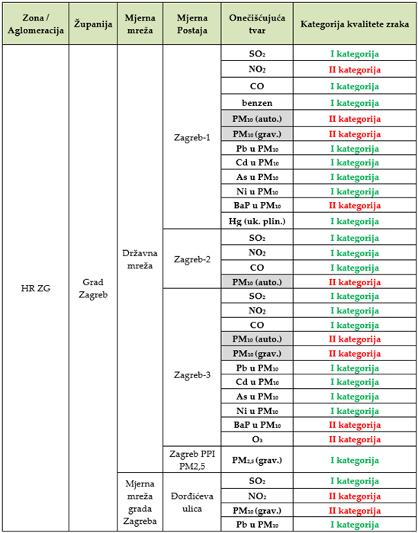
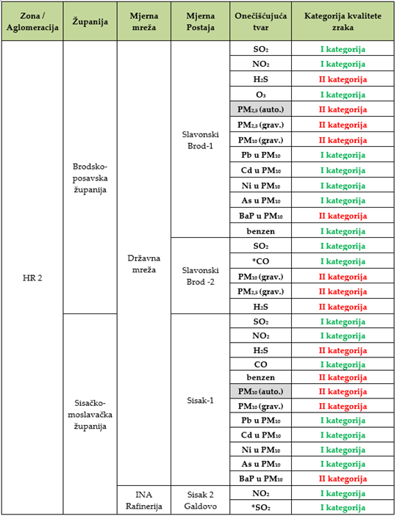
13.4 ANNUAL REPORTS
European Union IPA 2013 Programme for Croatia
Air quality categories - examples from the Agency's report
Energy Research and Environmental Protection Institute

Slide 34
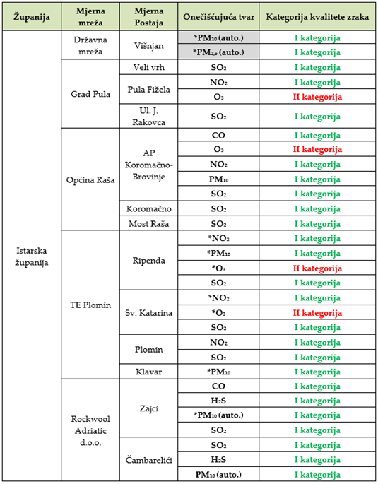
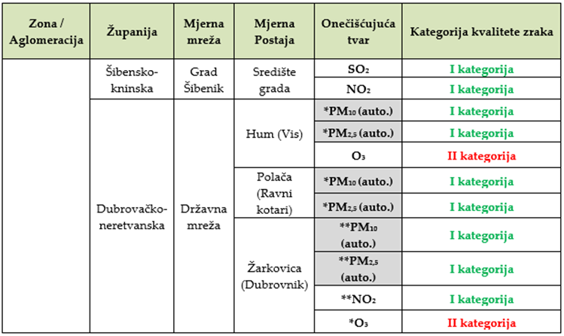
13.4 ANNUAL REPORTS
European Union IPA 2013 Programme for Croatia
Air quality categories - examples from the Agency's report
Energy Research and Environmental Protection Institute

Slide 35
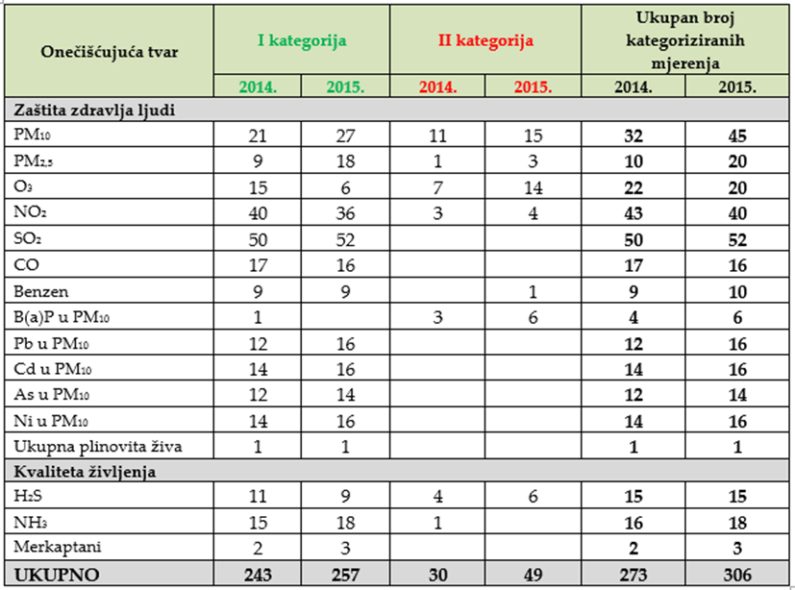
13.4 ANNUAL REPORTS
European Union IPA 2013 Programme for Croatia
Total number of categorized measuring point in the year 2014. and 2015. with number I and II category for each pollutant - Agency's report
Energy Research and Environmental Protection Institute

Slide 36
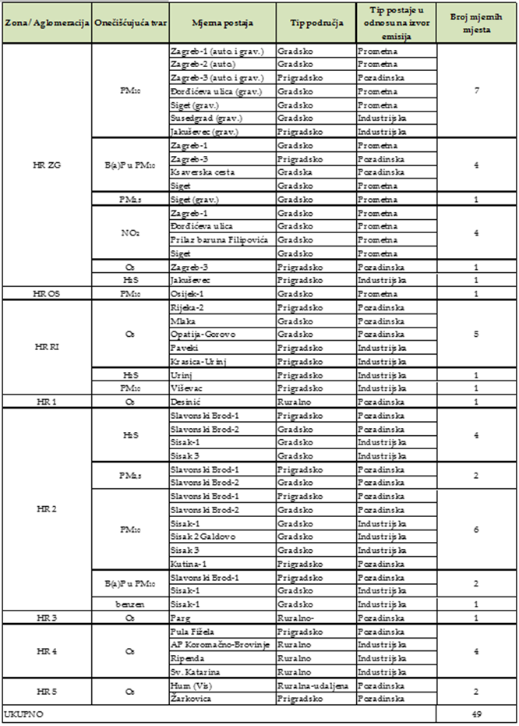
13.4 ANNUAL REPORTS
European Union IPA 2013 Programme for Croatia
Measurement sites by zones and agglomerations where air was the 2nd category for all pollutants in a year 2015.
Energy Research and Environmental Protection Institute

Slide 37
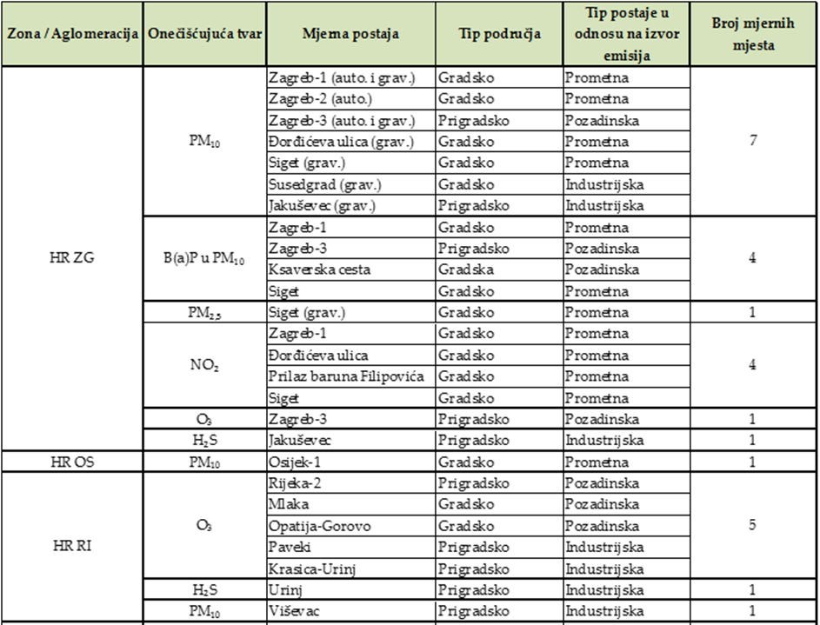
13.4 ANNUAL REPORTS
European Union IPA 2013 Programme for Croatia
Measurement sites - agglomerations on which air was the 2nd category for all pollutants in a year 2015.
Energy Research and Environmental Protection Institute

Slide 38
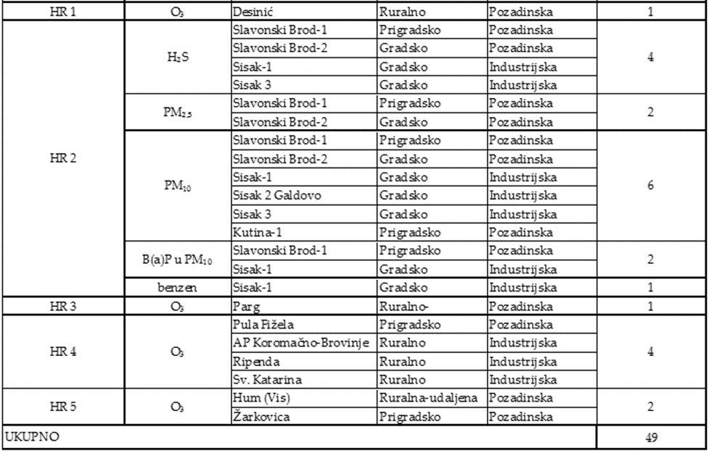
13.4 ANNUAL REPORTS
European Union IPA 2013 Programme for Croatia
Measurement sites - the zones where the air was 2nd category for all pollutants in a year 2015.
Energy Research and Environmental Protection Institute

Slide 39
13.4 ANNUAL REPORTS
European Union IPA 2013 Programme for Croatia
Based on the reports, the Agency produces an annual report on air quality in the Republic of Croatia
for at least measurement sites for the monitoring of sulfur dioxide, nitrogen oxides, particulate matter (PM₁₀ and PM_{2,5}), lead, benzene, carbon monoxide, ozone and ozone precursors, arsenic, cadmium, mercury, nickel, benzopyrene and other polycyclic aromatic hydrocarbons in air used for the mutual exchange of information and reporting on air quality between the Agency and the European Commission,
can be made as needed for other measurement site and contain other data as needed
http://iszz.azo.hr/iskzl/godizvrpt.htm?pid=0&t=0
Energy Research and Environmental Protection Institute

Slide 40
13.4 ANNUAL REPORTS
European Union IPA 2013 Programme for Croatia
The Agency’s report contains:
air pollution assessment by pollutants for each zone and agglomeration
summary levels that exceed the limit values, target values, long-term goals, information thresholds and alert thresholds for relevant times. This data is combined with a summary assessment of the exceeding effects
additional data and estimates of forest protection when available, as well as data on other pollutants for which the monitoring provisions set out in this Regulation, such as, inter alia, some ozone precursors that are not regulated by regulations and which are listed in the Regulation on Levels.
Energy Research and Environmental Protection Institute

Slide 41
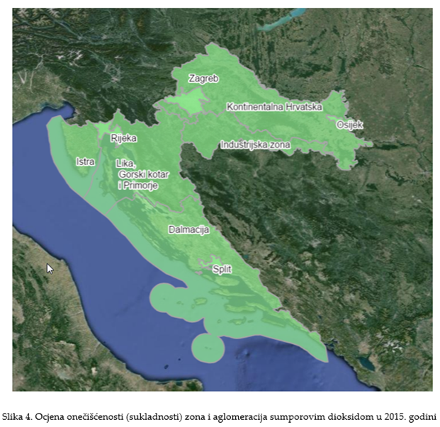
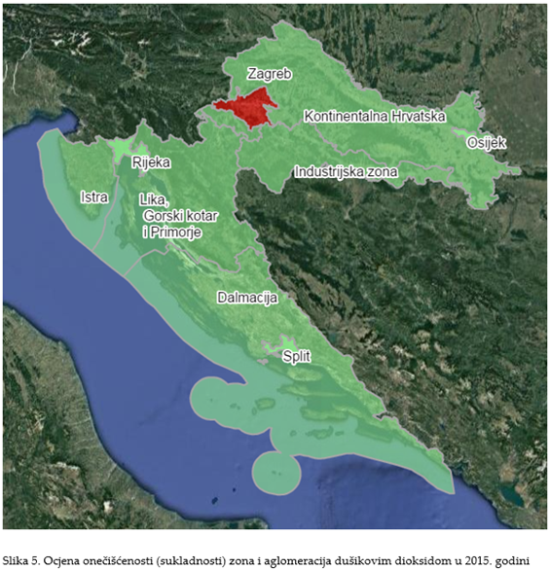
13.4 ANNUAL REPORTS
European Union IPA 2013 Programme for Croatia
The Agency’s report - air pollution assessment by pollutants for each zone and agglomeration (examples)
Energy Research and Environmental Protection Institute

Slide 42
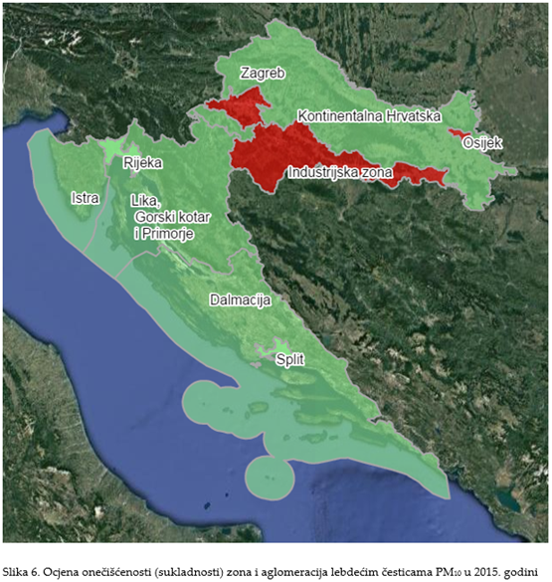
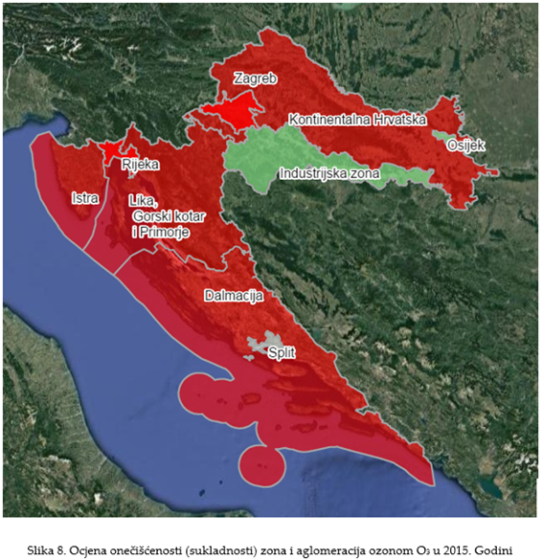
13.4 ANNUAL REPORTS
European Union IPA 2013 Programme for Croatia
The Agency’s report - air pollution assessment by pollutants for each zone and agglomeration (examples)
Energy Research and Environmental Protection Institute

Slide 43
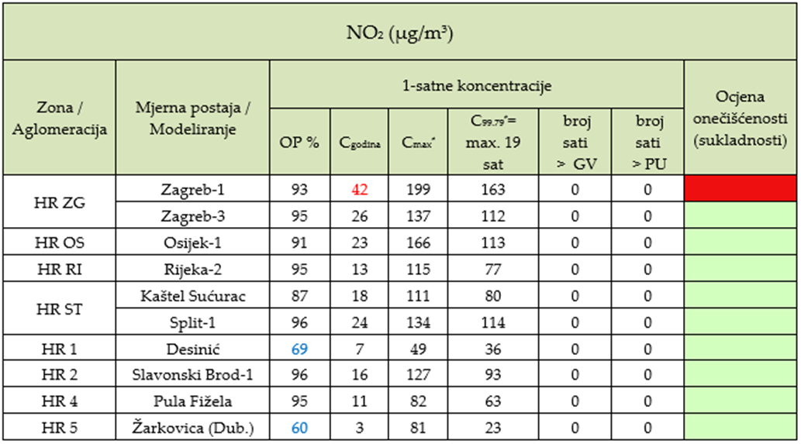
13.4 ANNUAL REPORTS
European Union IPA 2013 Programme for Croatia
The Agency’s report - summary levels exceeding threshold values, target values, long-term goals, information thresholds and warning thresholds, for relevant mediation times (examples)
Energy Research and Environmental Protection Institute

Slide 44
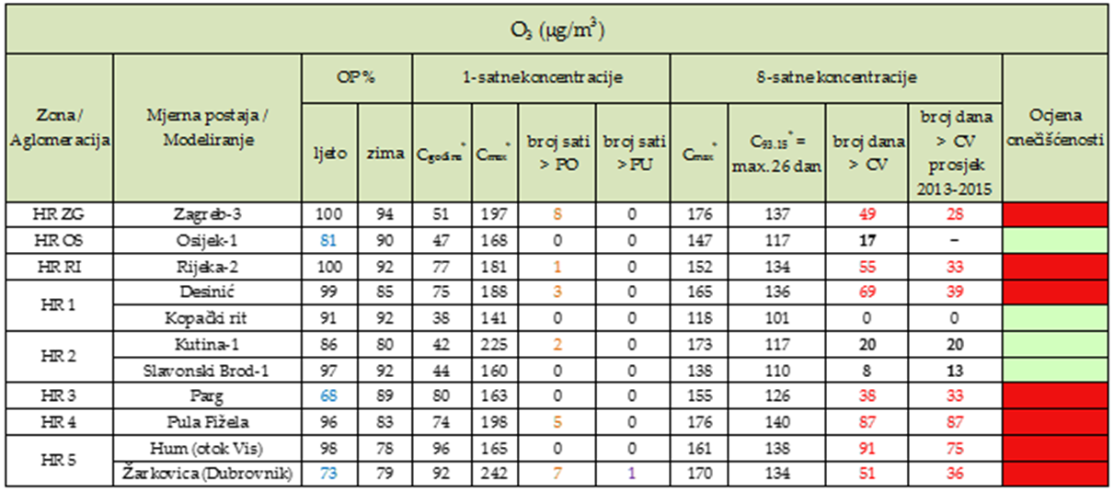
13.4 ANNUAL REPORTS
European Union IPA 2013 Programme for Croatia
The Agency’s report - summary levels exceeding threshold values, target values, long-term goals, information thresholds and warning thresholds, for relevant mediation times (examples)
Energy Research and Environmental Protection Institute

Slide 45
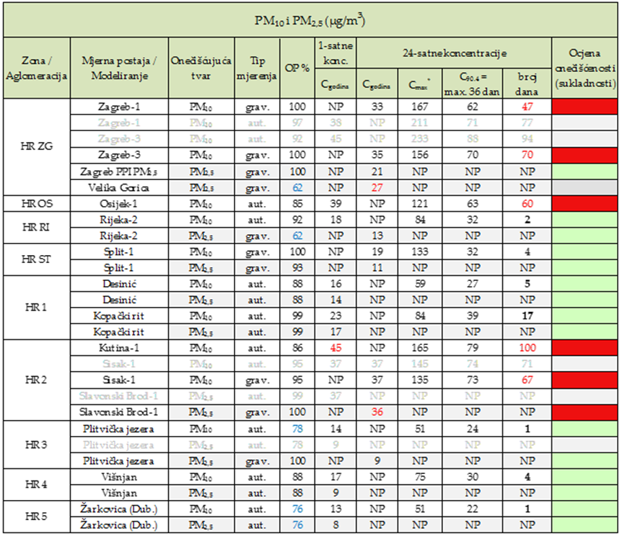
13.4 ANNUAL REPORTS
European Union IPA 2013 Programme for Croatia
The Agency’s report - summary levels exceeding threshold values, target values, long-term goals, information thresholds and warning thresholds, for relevant mediation times (examples)
Energy Research and Environmental Protection Institute

Slide 46



13.4 ANNUAL REPORTS
European Union IPA 2013 Programme for Croatia
The Agency submits to the Ministry (competent authority) an annual report on the territory of the Republic of Croatia by September 30th of the current year for the previous calendar year and publishes it on its web site.
Energy Research and Environmental Protection Institute

Slide 47
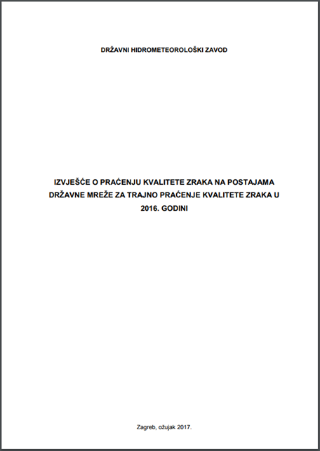
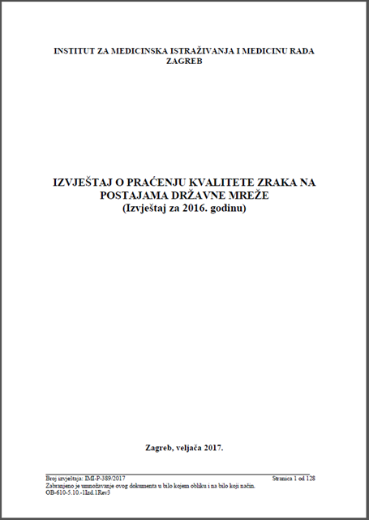

13.4 DATA SUBMISSION DYNAMICS
European Union IPA 2013 Programme for Croatia
State Network - The National Hydrometeorological Institute submits to the Ministry and Agency original and validated data and air pollution reports on levels and quality assessment by April 30th of the current year for the previous calendar year.
Energy Research and Environmental Protection Institute

Slide 48
13.4 DATA SUBMISSION DYNAMICS
European Union IPA 2013 Programme for Croatia
Local Networks (JRS and JLS)
The legal entity - the testing laboratory shall carry out the sourse and validated air quality monitoring data and air pollution report and air quality assessment to the competent administrative body of the County, City of Zagreb and the city by 31th March of the current year for the previous calendar year.
The competent authority of the counties, the City of Zagreb and the cities shall submit the Agency with original and validated data and air pollution reports and air quality assessment by 30th April of the current year for the previous calendar year.
Energy Research and Environmental Protection Institute

Slide 49


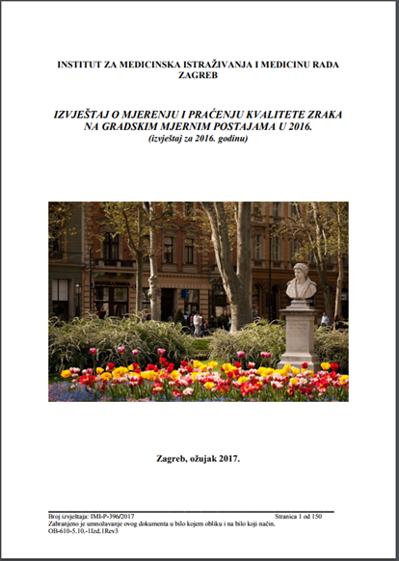

13.4 DATA SUBMISSION DYNAMICS
European Union IPA 2013 Programme for Croatia
Local Networks (JRS and JLS) – reports examples
Energy Research and Environmental Protection Institute

Slide 50
13.4 DATA SUBMISSION DYNAMICS
European Union IPA 2013 Programme for Croatia
Local Networks (JRS i JLS)
The legal entity - the testing laboratory carrying out the measurements for the pollutant shall submit original and validated air quality monitoring data and air pollution report and air quality assessment to the competent administrative body of the County, City of Zagreb and by March 31th of the current year for the previous calendar year.
The competent authority of the counties, the City of Zagreb and the cities shall submit to the Agency with source and validated data and air pollution reports and air quality assessment by April 30th of the current calendar year for the previous calendar year.
Energy Research and Environmental Protection Institute

Slide 51
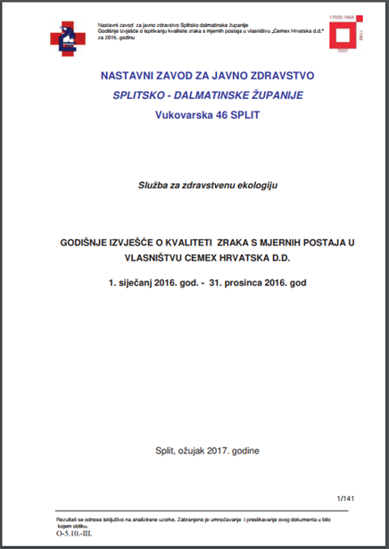

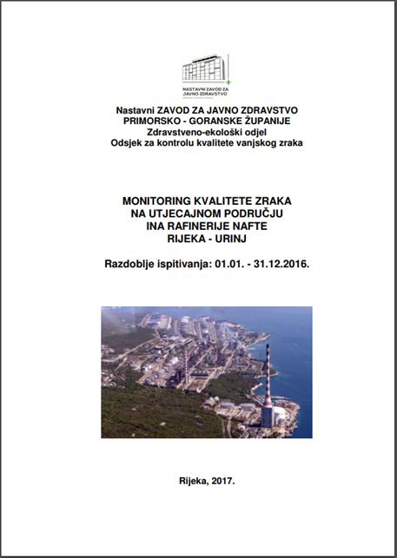
13.4 DATA SUBMISSION DYNAMICS
European Union IPA 2013 Programme for Croatia
Local Networks (Polluter) – reports examples
Energy Research and Environmental Protection Institute

Slide 52
13.4 DATA SUBMISSION DYNAMICS
European Union IPA 2013 Programme for Croatia
Local Networks - measurements of special purpose Article 33. Air Protection Act
Art. 34. Air Protection Act and Art. 23. Ordinance define reporting only for measurements in accordance with Art. 31 and 32 and omits measurements of special purpose according to Art. 33.
Even in Part XIII, INSPECTION SURVEILLANCE is not explicitly described as to who controls the measurement or reporting of these measurements.
There are no such reports on Agency’s pages
Energy Research and Environmental Protection Institute

Slide 53
THANK YOU FOR YOUR ATTENTION
Energy Research and Environmental Protection Institute
Disclaimer: The contents of this publication are the sole responsibility of EKONERG – Energy Research and Environmental Protection Institute, Ltd. and can in no way be taken to reflect the views of the European Union
This project is funded by the European Union

